Slide 1
Academic Performance Prediction Report
Prepared By: Subhajit Sarkar
Date: 14/03/2018
Analysis Software: SAS

Slide 2
Report Contents
Business Key Parameters
Project Objective
Description of Variables
Overall Conditions
Outcomes
Conclusion
Business Strategy

Slide 3
BUSINESS KEY PARAMETERS
Average Education of Parents (avg_ed)
Percentage of Full-Time Teachers (pct)
Percentage of English Language Learners (ell)
Dropout rate (mobility)

Slide 4
PROJECT OBJECTIVE
Predicting academic performance of an elementary school using attributes like class size, enrollment, poverty, parent education, student performance, teachers credentials from 400 elementary schools from the California Department of Education's API 2000 dataset.

Slide 5
DESCRIPTION OF VARIABELS

Slide 6
OVERALL CONDITIONS
1. OVERALL SIGNIFICANCE (P < ALPHA)
2. MULTICOLLINEARITY - VIF <=1.5
3. INDIVIDUAL SIGNIFICANCE - P < ALPHA
4. HOMOSCEDASTICITY CHECK - P > ALPHA
5. NORMALITY CHECK - P > APLHA
6. MAPE <=10%
7. R - SQUARE >= 65%

Slide 7
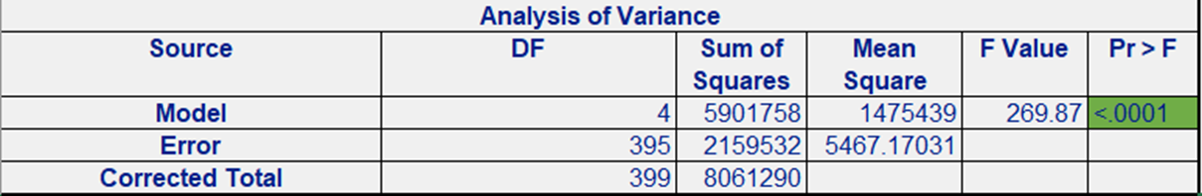
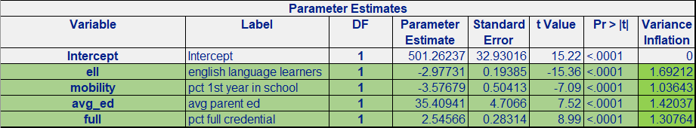
OUTCOMES
1. Overall Significance:
2. Multicollinearity:

Slide 8
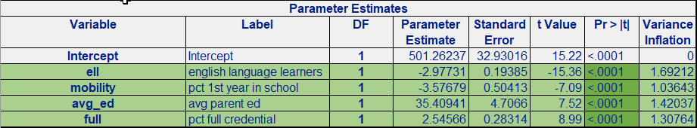
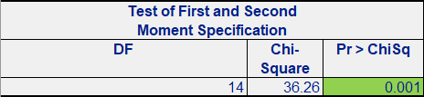
OUTCOMES -CONTINUED
3. Individual Significance:
4. Homoscedasticity Check:

Slide 9
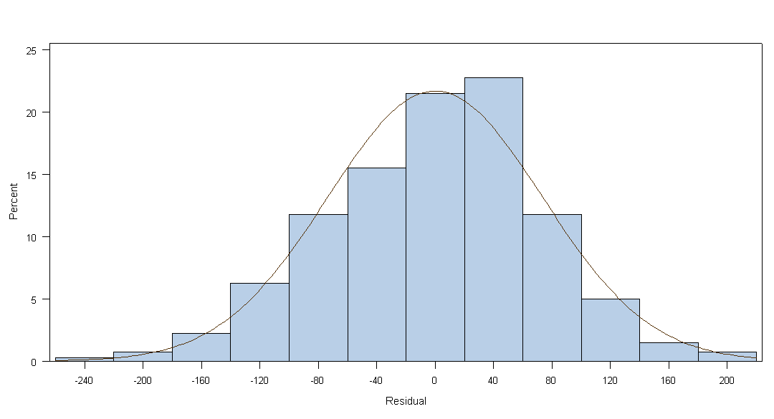
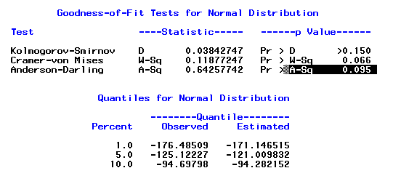
OUTCOMES -CONTINUED
5. Normality Check:

Slide 10


OUTCOMES -CONTINUED
6. MAPE:
7. Overall R-Square:

Slide 11
CONCLUSION
The results of the study indicates how the key variables effect the Academic Performance of
different elementary schools. But if you’re looking for key performance indicators, you know
that there are hundreds to select from. From the outcomes of different statistical tests we
can conclude that, out of 20 variables in the dataset, 4 variables are significant enough for
predicting the Performance Indicator variable(API00). The Average Education of Parents and
Percentage of Full-Time Teachers have positive impact on the Academic Performance of
students, whereas, Percentage of English Language Learners and Dropout Rate has negative
impact. By changing and improving different variables, schools can improve the
performance of students.

Slide 12
BUSINESS STRATEGY
The Academic Performance Indicator (API) is a type of performance measurement that helps
you understand how your students are performing and allows you to understand if you’re
headed in the right direction with your strategy.
By looking at different parameters, schools can focus on specific areas to help the students
improve their overall performance.
As a result, they can effectively and efficiently streamline investment and workforce
development to increase performance.

